Slide 1
Titanic Insights and Lessons for Modern Safety Measures
Analyzing Survival Patterns and Recommendations for Future Safety
Name - Sumit Baviskar
Date – 11 Jan 2025

Slide 2
OVERVIEW
Objective:
Analyze passenger demographics, fare distribution, and survival trends.
Provide actionable insights to improve modern safety measures.
Key Areas of Analysis:
Gender and Survival Trends
Class and Fare Impact on Survival
Age-Based Survival Patterns
Recommendations for Safety Improvements

Slide 3
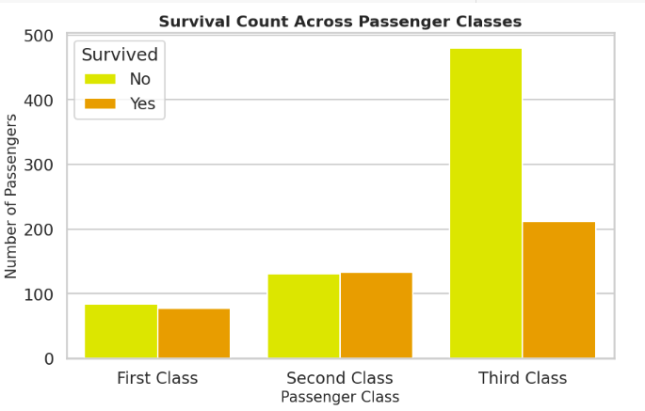
GENDER IMPACT ON SURVIVAL
Higher Female Survival Rates: Across all classes, females had higher survival rates than males.
Class Variation: First-class passengers of both genders had the highest survival rates, with survival disparity decreasing in lower classes.
Third-Class Male Risk: Males in third class had the lowest survival rates and highest mortality risk.

Slide 4
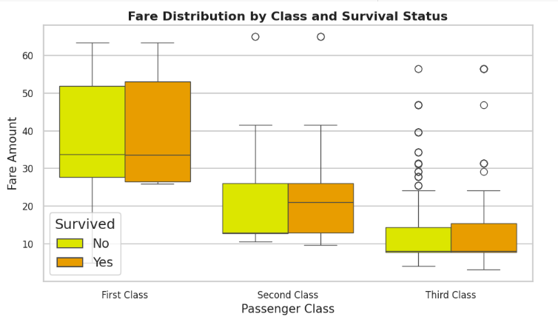
CLASS AND FARE DISTRIBUTION
Higher Fares in First Class: First-class passengers consistently paid the highest fares, reflecting access to better amenities and safety resources.
Second and Third Class: Moderate fares in second class, with third class showing the most affordable and consistent fares across age groups.
Survivors vs. Non-Survivors: Survivors in all classes tended to pay slightly higher fares on average than non-survivors.

Slide 5
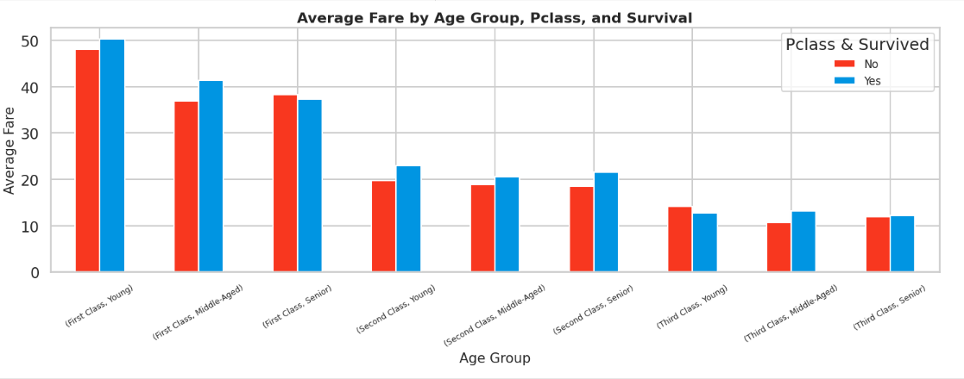
AGE IMPACT ON SURVIVAL
Younger Passengers: Children had higher survival rates compared to middle-aged and senior passengers.
Age Difference in Survival: Survivors across all age groups were slightly younger than non-survivors.
Class-Specific Patterns: Younger passengers in first class paid lower fares compared to seniors.

Slide 6

SOCIOECONOMIC INFLUENCE
First-Class Advantage: Survival rate of 48% in first class compared to 30% in third class.
Class Inequality: Third-class passengers faced the highest mortality, with 480 non-survivors.
Fares and Safety: Higher-paying passengers had better access to lifeboats and evacuation routes.

Slide 7
RECOMMENDATIONS
Improved Safety Measures:
Equitable Evacuation Policies: Ensure all passengers, regardless of class, have equal access to lifeboats and safety resources.
Enhanced Ship Design: Balanced placement of lifeboats and evacuation routes to reduce class-based disparities.
Comprehensive Training: Regular emergency preparedness drills for both crew and passengers to promote efficient and unbiased evacuation.
Data-Informed Planning: Leverage historical data to optimize safety protocols for modern maritime transport.

Slide 8
CONCLUSION
Key Takeaways:
The Titanic disaster underscores the importance of equitable safety measures.
Gender, class, and age significantly influenced survival outcomes.
Historical data serves as a critical tool for designing inclusive safety protocols.

Slide 9
Questions
Thank You! Feel free to ask any questions or share your thoughts.

